Slide 1
Solr Overview and Solr Optimization

Slide 2
Table of Contents
Introduction to Solr
Why is Alfresco using Solr?
How is Solr integrated with Alfresco?
Solr Architecture variations method
Solr Server Sizing
Solr Tuning

Slide 3
Introduction to Solr
Apache Solr is an open source enterprise search server.
It uses Apache Lucene as indexing and search engine at the backend.
It is written in Java and provides plug-in interfaces for building extensions to the search server. It exposes Lucene’s Java API as REST like API’s which can be called over HTTP from any programming language.
It can be run on any application server such as Apache Tomcat, Jboss etc.

Slide 4
Why is Alfresco using Solr?
Search performance can be scaled separately from the Alfresco repository (for example, two Solr instances for a four cluster node)
Fixed tokenization to support better cross-language support
No in-transaction indexing
Improved performance on the PATH implementation
Build in Administration UI
Faceted navigation search
More items like this(Recommendation)/Related Search
Spell Suggest/Auto-Complete
Custom document ranking/ordering
Geospatial search for filtering and sorting by distance.
Awesome community support too

Slide 5
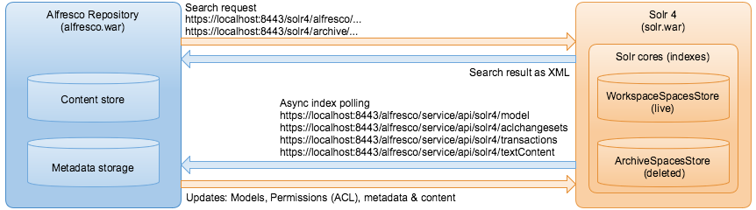
How is Solr integrated with Alfresco?
Two main Solr Cores (Live content and archived content)
By default the Solr that comes with Alfresco contains 2 cores, the live content core (workspaces:spacesStore) and the archived content (archive:spacesStore). Each of this cores contains the indexes for their particular set of content.

Slide 6
Solr Architecture variations method
There are 3 different architecture variations than can be considered while using Solr with Alfresco on a cluster.
Lets address cluster-based configurations that include the following advantages:
Alfresco - > Solr search load balancing
This is the most obvious use case for scalability purposes. Search requests are
directed from Alfresco to a pool of Solr instances, each of which contains a full copy
of the index and is able to service requests in a purely stateless fashion.
Solr -> Alfresco index tracking balancing
In the other direction, Solr nodes use a load balancer to redirect their index tracking
requests to one or multiple dedicated/shared Alfresco nodes. This is useful in case of
large indexing load, due to a heavy concurrent write/update scenario.

Slide 7
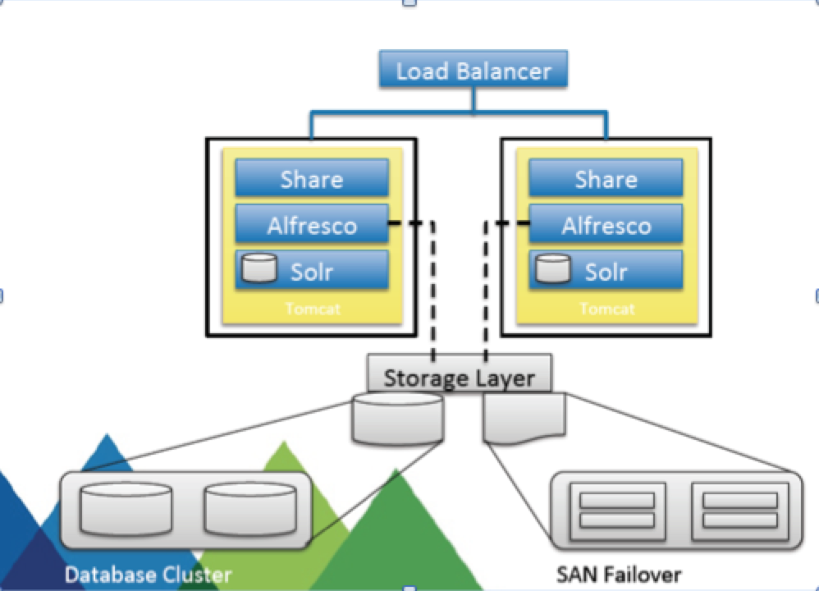
Option 1 - Solr in the same machine as alfresco, non dedicated tracking

Slide 8
Option 1 - Solr in the same machine as alfresco, non dedicated tracking
On this architecture we have a solr instance deployed on the same application server
of both alfresco and share web-applications.
Advantages:
Easy to maintain / backup.
Disadvantages:
Shared JVM, if Solr crashes both Alfresco and Share become unavailable.
Shared hardware, Memory is shared between all layers of the application
When Solr downloads content, there is transformation load to generate the indexing text file (CPU/Memory intensive) on the Alfresco side, having everything on the same box impacts both search and indexing as all the applications are on the same application server sharing its resources like the connection pools, threads, etc.
Only possible to scale vertically (Only possible to add more CPU and Memory)

Slide 9
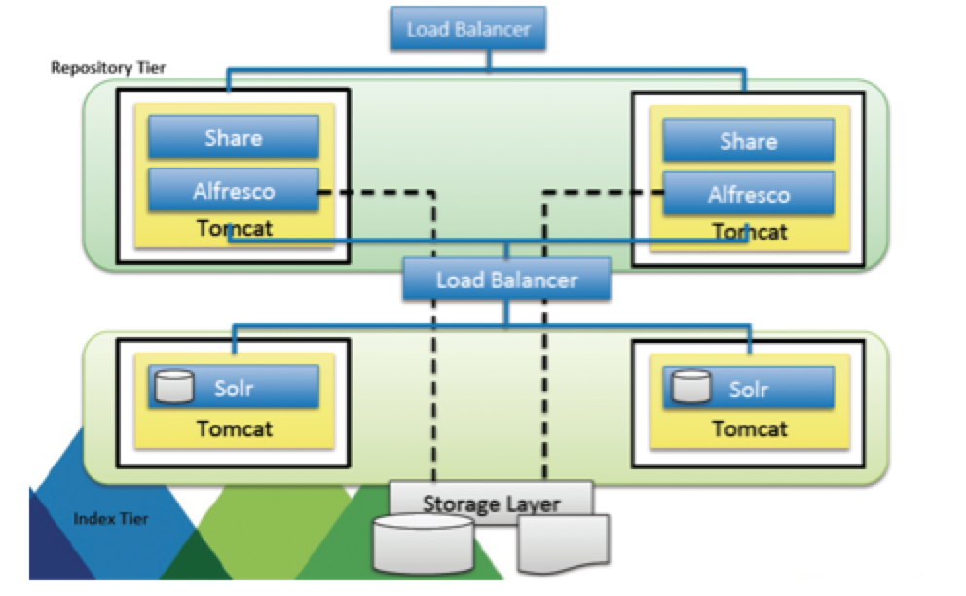
Option 2 - Solr separated from alfresco - Non-Dedicated tracking

Slide 10
Option 2 - Solr separated from alfresco - Non-Dedicated tracking
On this architecture variation we have the Solr instances deployed on separated machines and
Application servers from alfresco and share.
Advantages:
Simple upgrade, administration and maintenance of Solr server’s farm
Allows for vertical and horizontal scalability
Introduces the ability to load balance the queries
Ready for Future Solr sharding feature
It’s expected that alfresco will support, on a near future the ability to slit the index on different solr instances that will lead to increased performance, this architecture is ready to implement that feature.
Disadvantages:
Remote Tracking can stress the network, if network problems occur solr performance gets affected.

Slide 11
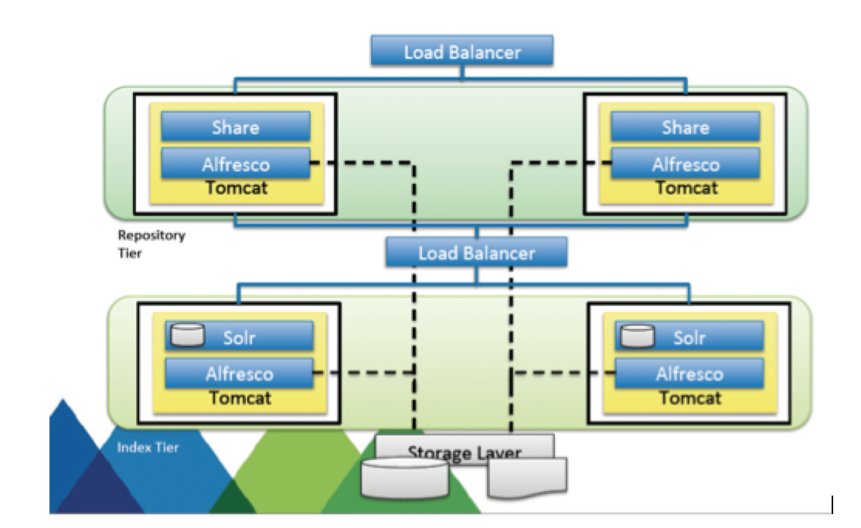
Option 3 - Solr server with a dedicated tracking Alfresco instance

Slide 12
Option 3 - Solr server with a dedicated tracking Alfresco instance
On this architecture variation we use dedicated alfresco instances on the solr servers that are
only used for indexing and do not receive or process any user’s requests. These local alfresco
instances take care of important CPU/Memory intensive operations such as the transformations
and the overall tracking and indexing actions. With this scenario the repository Tier is released
from those operations resulting on a overall performance gain. This Alfresco instances are not
part of the cluster and do not require ehcache configuration.
Advantages:
Indexing operations offloaded from repository and client tier
Dedicated Alfresco for transformation operations
Allow for specific transformations tuning on the index tier and on the repository tier considering the use cases. Transformation for previews and thumbnails (share related) and transformations for Solr indexing.
Allows for Vertical and horizontal scalability
General performance increase
Disadvantages:
None, this is the best solution compared to others.

Slide 13
Solr Server Sizing
Sizing your Solr servers depends a lot on the specific search requirements of your project. The important factors you need to consider are :
Search Ratio: To get the search ratio you should divide the typical usage of the system in Read/Write/Search.
Number of Documents in the repository
Group Hierarchy
Number of ACLs
Amount of CPU Cores you have available ( the more the better :))
Alfresco provides a formula that helps you to calculate the ammount of memory needed on your Solr servers, check the following url for guidance. http://docs.alfresco.com/community/concepts/solrnodes-memory.html

Slide 14
Solr Tuning
Solr, when properly tuned It’s extremely fast, easy to use, and easy to scale
There are two main disciplines to consider for Solr Tuning:
Indexing data (writing/committing)
Search for data (reading/querying)
It’s important to mention that there is no rule of thumb that enables you to
maximize your Solr performance for every project.
Solr tuning is an exercise that highly depends on the specific project use cases,
architecture and business scenarios. Depending on the particularities of your
project, the actions to perform may vary in terms of what needs to be done to
achieve best Solr performance.

Slide 15
Solr Indexing Tuning
Have local indexes (don’t use shared folders, NFS, use Fast hardware (RAID, SSD,..)
Manage wisely your Ram buffer size (ramBufferSizeMB) on solrconfig.xml
Tune the mergeFactor, 25 is ideal for indexing, while 2 is ideal for search. To maximize indexing performance use a mergeFactor of 25.
During the indexing, plug in a monitoring tool (YourKit) to check the repository health during the indexing. Sometimes, during the indexing process, the repository layer executes heavy and IO/CPU/Memory intensive operations like transformation of content to text in order to send it to Solr for indexing. This can become a bottleneck when for example the transformations are not working properly or the GC cycles are taking a lot of time.
Monitor closely the JVM health of both Solr and Alfresco (GC, Heap usage)

Slide 16
Solr Indexing Tuning (Continue)
Solr operations are memory intensive so tuning the Garbage collector is an important step to achieve good performance.
Consider if you really need tracking to happen every 15 seconds (default). This can be configured in Solr configuration files on the Cron frequency property. alfresco.cron=0/15 * * * * ? *
Increase your index batch counts to get more results on your indexing webscript on the repository side. In each core solrcore.properties, raise the batch count to 2000 or more alfresco.batch.count=2000
In solrconfig.xml of each core configure the ramBufferSize to be at least 64 Mb , you can even use 128 if you have enough memory .
<ramBufferSizeMB>64</ramBufferSizeMB>
In solrconfig.xml of each core configure the mergeFactor to 25, this is the ideal value for indexing. <mergeFactor>25</mergeFactor>

Slide 17
Solr Indexing Tuning (Continue)
Disable Full Text Indexing on archive:SpacesStore Solr, this is done by adding the property alfresco.index.transformContent=false. Alfresco never searches for content inside files that are deleted/archived. This saves on disk space, memory on Solr, Cpu during Indexing and overall resources.
Tune the transformations that occur on the repository side, set a transformation timeout.
Most Important project questions need to address:
SSL really needed? If inside the intranet, you should disabled to reduce complexity.
Full Text indexing really necessary, some customers do full text index but they don’t actually use it.
Is an archive core really necessary for indexing, if you are not making use of this indexing core, it would be beneficial to disable it.

Slide 18
Solr Search Tuning
Use local folders for the indexes (don’t use shared folders, NFS)
Use Fast hardware (RAID, SSD,..)
Tune the mergeFactor, a mergeFactor of 2 is ideal for search.
Decrease the Solr caches, specially when running an Alfresco version prior to 4.1.4.
Increase your query caches and the RAMBuffer.
Avoid path search queries, those are know to be slow.
Avoid using sort, you can sort your results on the client side using js or any client side framework of your choice.
Avoid * search, avoid ALL search
Tune your Garbage collector policies and JVM memory settings.
Consider lowering your memory on the JVM if the total heap that you are assigning is not being used. Big JVM heap sizes lead to bigger GC pauses.
Get the fastest CPU you can, search is CPU intensive rather then RAM intensive.

Slide 19
Solr Search Tuning (Continue)
Separate search and indexing tiers. If you can have 2 separate solr server farms, you can dedicate one to the indexing and the other to search. This will increase your global
performance ( Only available since alfresco 4.2.X )
Optimize your ACL policy, re-use your permissions, use inherit and use groups. Don’t setup specific permissions for users or groups at a folder level. Try to re-use your Acls.
Upgrade your Alfresco release with the latest service packs and hotfixes. Those contain the latest Solr improvements and bug fixes that can have great impact on the overall search performance.
Make sure you are using only one transformation subsystem. Check the alfresco-global.properties and see if you are using either OooDirect or JodConverter, never enable both sub-systems.

Slide 20
References
Referred website URLs :
http://docs.alfresco.com/5.1/tasks/solr4-install-config.html
https://wiki.apache.org/solr/SolrPerformanceFactors
20

